Slide 1
Monthly Sector sentiment Run
Hedgeye Materials
August

Slide 2
Criteria and methodology
Sample of 152 materials companies (BBG Screen)
SECTOR: Basic Materials
SUB-SECTORS: Aluminum, Coal, Commodity Chemicals, Construction Materials, Diversified Chemicals, Diversified Metals & Mining, Fertilizer & Ag. Chems, Forest Products, Gold, Industrial Gases, Paper Packaging, Paper Products, Silver, Specialty Chemicals, Steel, Trading Companies & Distribution
INDICES: U.S., Canada, Australia, Western Europe, VALE
DOMICILE: Australia, Canada, U.S., Western Europe
MARKET CAP: >$1BN
*Note: If a metric is not available for a given company, it is excluded from the screen. For example, short-interest is available for 94 out of 152 companies
Data source: HRM, BBg

Slide 3
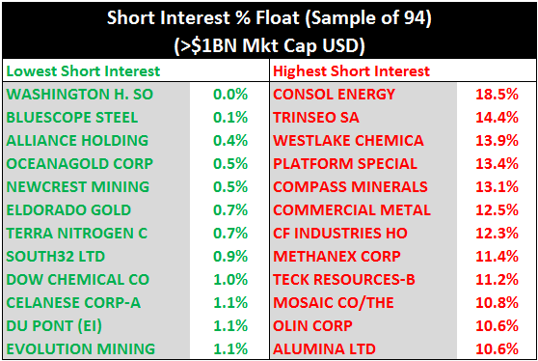
Short-interest
Chemical companies (Basic, Diversified, Fertilizer) have overtaken metals names since our July sentiment run. 8 of 12 of the highest short interest names are chemicals companies.
Data source: bbg

Slide 4
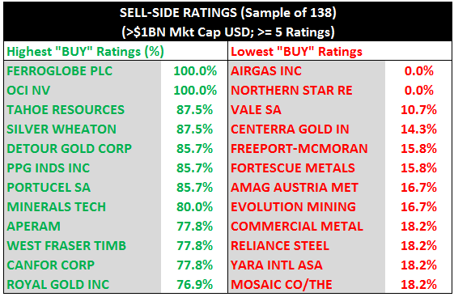
Sell-side Buy ratings
Comprises companies in the sample of 152 that have >= 5 sell-side ratings
Low buy ratings in the metals & mining space. Throughout 2016, Fertilizer sentiment is also low with fertilizers names on both the high short-interest and low “buy” ratings list
Data source: BBG

Slide 5
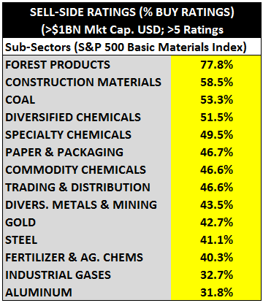
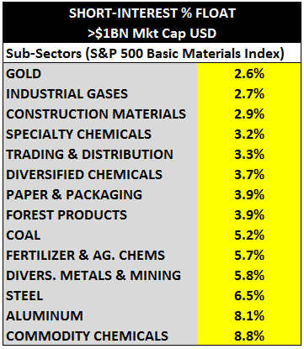
Sub-sector sentiment
Buy ratings and short-interest
Data source: BBG

Slide 6
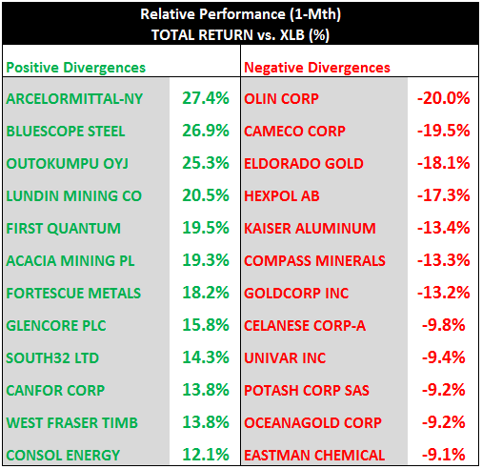
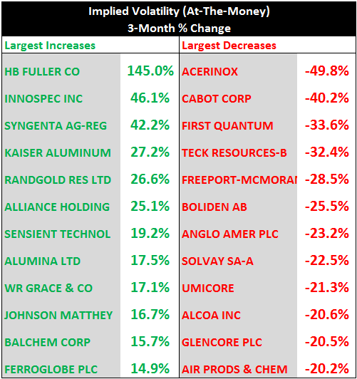
Relative performance (Short duration)
1-Month & 3-Month vs. S&P 500 Materials ETF (XLB)
Data source: bbg

Slide 7
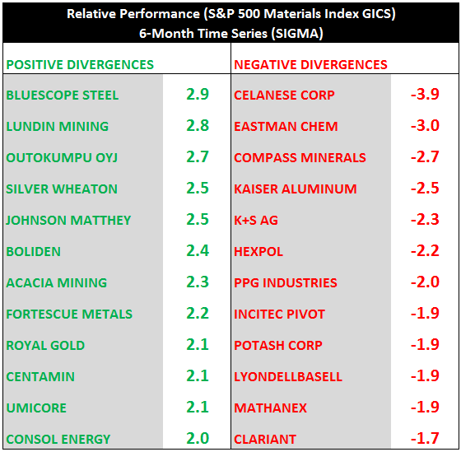
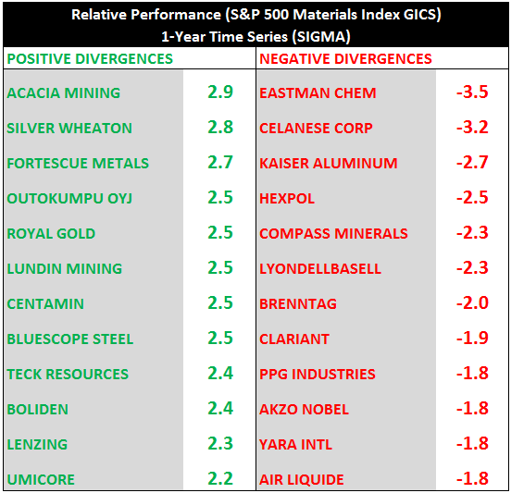
Relative performance (Long duration)
6-month & 1-Year (stdev Basis) vs. S&P 500 Materials Index
Data source: bbg

Slide 8
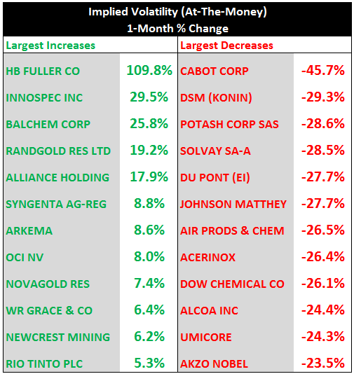
Implied volatility changes
1 & 3 Month changes
Data source: BBg

Slide 9
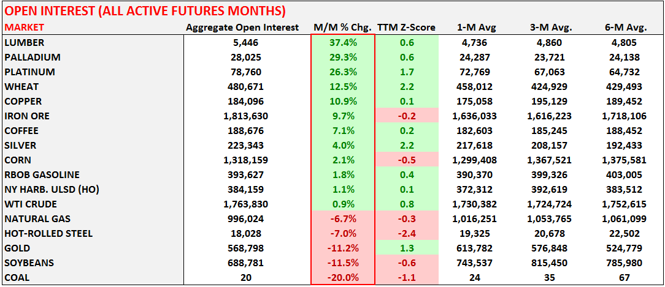
Open interest (active futures months)
Open interest increased substantially for the 1st half of 2016 in gold as investors piled in on the long-side. Some of the open interest has been trimmed m/m, with the majority of it cut w/w coming out of last week’s FOMC and GDP reports. Open interest has moved +10.9% higher in copper and net futures and options positioning is +2.0x and +3.0x on a TTM and 3-yr z-score basis
DATA SOURCE: BLOOMBERG

Slide 10
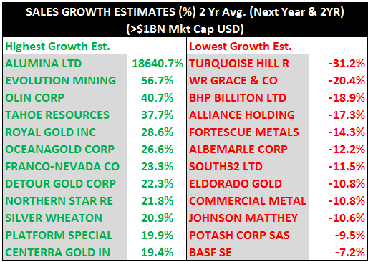
Sales growth estimates
Avg. of Next Fiscal YR. & 2-YR Growth Rate Expectations
Sell-side sales growth revisions put gold miners in the top (GDX +125% YTD).
Top-Line estimates among the non-gold mining companies remain depressed.
Data source: BBG

Slide 11
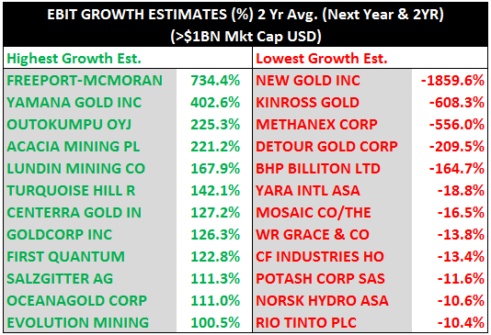
Ebit growth estimates
Avg. of Next Fiscal YR. & 2-YR Growth Rate Expectations
Estimates for SALES, EBIT, and EPS growth available for 148 of 152 in BBG screen
Data source: bbg

Slide 12
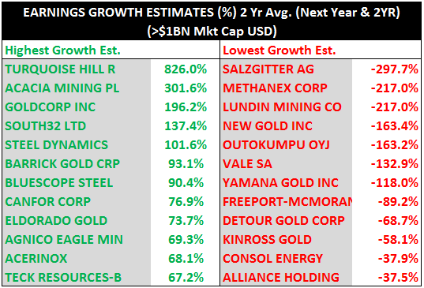
Earnings Growth Estimates
Avg. of next fiscal year & 2-Yr growth rate expectations
Like top-line
estimates, we see a
divergence in precious
metal earnings growth expectations. Gold Miners exist in both the top and bottom 12
possibly as a
result of lagged
revisions to sell-side
Expectations.
Data source: BBG

Slide 13
Q2 Reporting season
S&P 500 Materials sector
Data source: Bloomberg

Slide 14
Testing peak forward multiples again
S&p 500 GICS Materials sector Multiples
With declining earnings and estimates despite a double digit gain for XLB YTD, the sector is again testing peak forward multiple expectations.
Q2 2016 would mark the 4th consecutive quarter of negative Y/Y earnings growth in the sector.
Data source: BBG

Slide 15
For more information contact:
SALES@HEDGEYE.COM
203.562.6500

